Slide 1
Virtual Memory

Slide 2
Virtual Memory
Background
Demand Paging
Page Replacement
Allocation of Frames
Thrashing
Demand Segmentation
Operating System Examples

Slide 3
Background
Virtual Memory is a technique that allows the execution of processes that are not completely in memory.
One major advantage of this scheme is that programs can be larger than physical memory.

Slide 4
Background
Virtual memory – separation of user logical memory from physical memory.
  Only part of the program needs to be in memory for execution.
  Logical address space can therefore be much larger than physical address space.
  Allows address spaces to be shared by several processes.
  Allows for more efficient process creation.
Virtual memory can be implemented via:
  Demand paging
  Demand segmentation

Slide 5

Virtual-address Space
The virtual address space of
a process refers to the logical
(or virtual ) view of how a
process is stored in memory.

Slide 6
Demand Paging
Loading the entire program into memory results in loading the executable code for all options , regardless of whether an option is ultimately selected by the user or not.
An alternative strategy is to initially load pages only as they are needed. This technique is known as demand paging and is commonly used in virtual memory systems.

Slide 7
Demand Paging
Bring a page into memory only when it is needed
  Less I/O needed
  Less memory needed
  Faster response
  More users
Page is needed ⇒ reference to it
  invalid reference ⇒ abort
  not-in-memory ⇒ bring to memory

Slide 8
Demand Paging
In demand-paged virtual memory ,
  Pages are only loaded when they are demanded during program execution.
  Pages that are never accessed are thus never loaded into physical memory.
A demand-paging system is similar to a paging system with swapping where processes reside in secondary memory (usually a disk).
Lazy swapper : A lazy swapper never swaps a page into memory unless that page will be needed.
A swapper manipulates entire processes, where as a pager is concerned with the individual pages of a process.

Slide 9
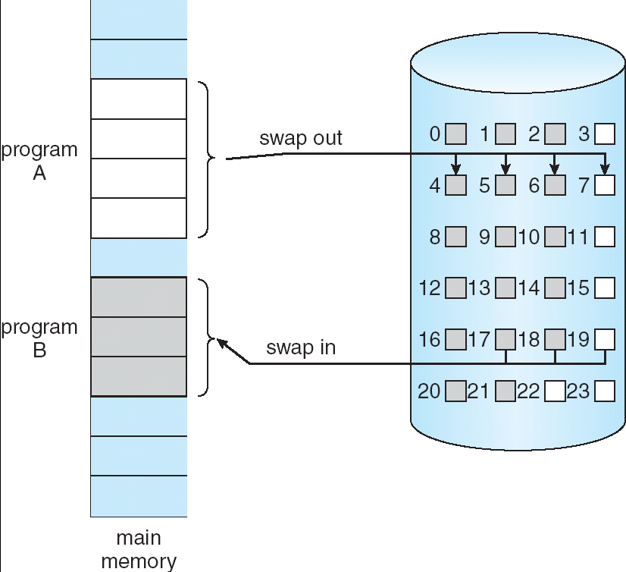
Transfer of a Paged Memory to Contiguous Disk Space

Slide 10
Valid-Invalid Bit
We need some form of hardware support to distinguish between the pages that are in memory and the pages that are on the disk.
The valid – invalid bit scheme can be used for this purpose.
With each page table entry a valid–invalid bit is associated
(1 ⇒ in-memory, 0 ⇒ not-in-memory)
Initially valid–invalid bit is set to 0 on all entries

Slide 11
Valid-Invalid Bit
Example of a page table snapshot:
During address translation, if valid–invalid bit in page table entry is 0 ⇒ page fault
Frame #
valid-invalid bit
1
1
1
1
0

0
0
page table

Slide 12

Page Table When Some Pages Are Not in Main Memory

Slide 13
Page Fault
If a process tries to access a page that was not brought into memory or
Access to a page marked invalid causes a page-fault trap.
The trap is the result of the operating system’s failure to bring the desired page into memory.

Slide 14
Page Fault
If there is ever a reference to a page, first reference will trap to
OS ⇒ page fault
OS looks at another table to decide:
  Invalid reference ⇒ abort.
  Just not in memory.
Get empty frame.
Swap page into frame.
Reset tables, validation bit = 1.
Restart instruction: Least Recently Used

Slide 15
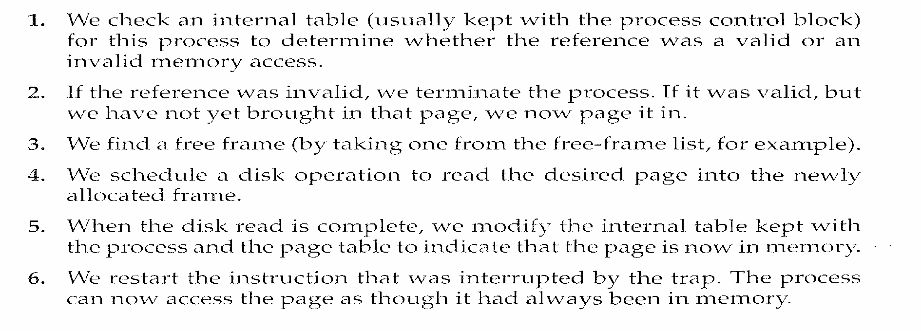

Slide 16

Steps in Handling a Page Fault

Slide 17
What happens if there is no free frame?
Page replacement – find some page in memory, but not really in use, swap it out
  algorithm
  performance – want an algorithm which will result in minimum number of page faults
Same page may be brought into memory several times

Slide 18

Need For Page Replacement

Slide 19
SOLUTION
Terminate the process which requires page fault ( No free frames) - not best choice.
Swap out a process.

Slide 20
Page Replacement
Basic Page Replacement.
FIFO Page Replacement.
Optimal Page Replacement.
LRU Page Replacement.
LRU – Approximation Page Replacement.
Counting – Based Page Replacement.

Slide 21
Basic Page Replacement
Find the location of the desired page on disk
Find a free frame:
- If there is a free frame, use it
- If there is no free frame, use a page replacement algorithm to select a victim frame
Read the desired page into the (newly) free frame. Update the page and frame tables.
Restart the process

Slide 22

Page Replacement

Slide 23
modify (dirty) bit
Use modify (dirty) bit to reduce overhead of page transfers – only modified pages are written to disk.
Each page or frame has a modify bit associated with it in the hardware.
The modified bit for a page is set by the hardware whenever any word or byte in the page is written into , indicating that the page has been modified.
If the bit is set -> Write the page to disk.
If the bit is not set ->Need not write the page to the disk.

Slide 24
Page Replacement Algorithms
Want lowest page-fault rate
Evaluate algorithm by running it on a particular string of memory references (reference string) and computing the number of page faults on that string
In all our examples, the reference string is
1, 2, 3, 4, 1, 2, 5, 1, 2, 3, 4, 5

Slide 25

Graph of Page Faults Versus The Number of Frames

Slide 26
First-In-First-Out (FIFO) Algorithm
Reference string: 1, 2, 3, 4, 1, 2, 5, 1, 2, 3, 4, 5
3 frames (3 pages can be in memory at a time per process)
4 frames
FIFO Replacement – Belady’s Anomaly
  more frames ⇒ more page faults
1
1
4
5
2
2
1
3
9 page faults
3
3
2
4
1
1
5
4
2
2
1
5
10 page faults
3
3
2
4
4
3

Slide 27

FIFO Page Replacement

Slide 28

FIFO Illustrating Belady’s Anomaly

Slide 29
Optimal Algorithm
Replace page that will not be used for longest period of time
4 frames example
1, 2, 3, 4, 1, 2, 5, 1, 2, 3, 4, 5
How do you know this?
Used for measuring how well your algorithm performs
1
4
2
6 page faults
3
4
5

Slide 30

Optimal Page Replacement

Slide 31
Least Recently Used (LRU) Algorithm
Reference string: 1, 2, 3, 4, 1, 2, 5, 1, 2, 3, 4, 5
Counter implementation
  Every page entry has a counter; every time page is referenced through this entry, copy the clock into the counter
  When a page needs to be changed, look at the counters to determine which are to change
1
5
2
3
5
4
4
3

Slide 32

LRU Page Replacement

Slide 33
LRU Approximation Algorithms
Reference bit
  With each page associate a bit, initially = 0
  When page is referenced bit set to 1
  Replace the one which is 0 (if one exists). We do not know the order, however.
Second chance
  Need reference bit
  Clock replacement
  If page to be replaced (in clock order) has reference bit = 1 then:
    set reference bit 0
    leave page in memory
    replace next page (in clock order), subject to same rules

Slide 34

Second-Chance (clock) Page-Replacement Algorithm

Slide 35
Counting Algorithms
Keep a counter of the number of references that have been made to each page
LFU Algorithm: replaces page with smallest count
MFU Algorithm: based on the argument that the page with the smallest count was probably just brought in and has yet to be used

Slide 36
Thrashing
If a process does not have “enough” pages, the page-fault rate is very high. This leads to:
  low CPU utilization
  operating system thinks that it needs to increase the degree of multiprogramming
  another process added to the system
Thrashing ≡ a process is busy swapping pages in and out

Slide 37

Thrashing (Cont.)

